Slide 1
Attack Vectors in DeFi Ecosystem
Chiachih Wu

Slide 2
About Me
@chiachih_wu
Co-Founder & Research VP at PeckShield
Auditing/Researching Smart Contracts/DApps/Blockchains
Founder & Former Team Lead of 360 C0RE Team
Hacking Android/Linux Since 2013
NC State Computer Science PhD (Virtualization/System Security)

Slide 3
DeFi Security Incidents
2018-12 Compound
2019-01 HUSD
2019-02 Nuo Network
2019-05 MakerDAO
2019-06 Synthetix Oracle
2019-07 Edgeware MLC DoS
2019-07 0x Signature Verification
2019-09 AirSwap Wrapper Authentication
Smart Contract
Business Logic
Smart Contract
Smart Contract
Oracle
Smart Contract
Smart Contract
Smart Contract

Slide 4
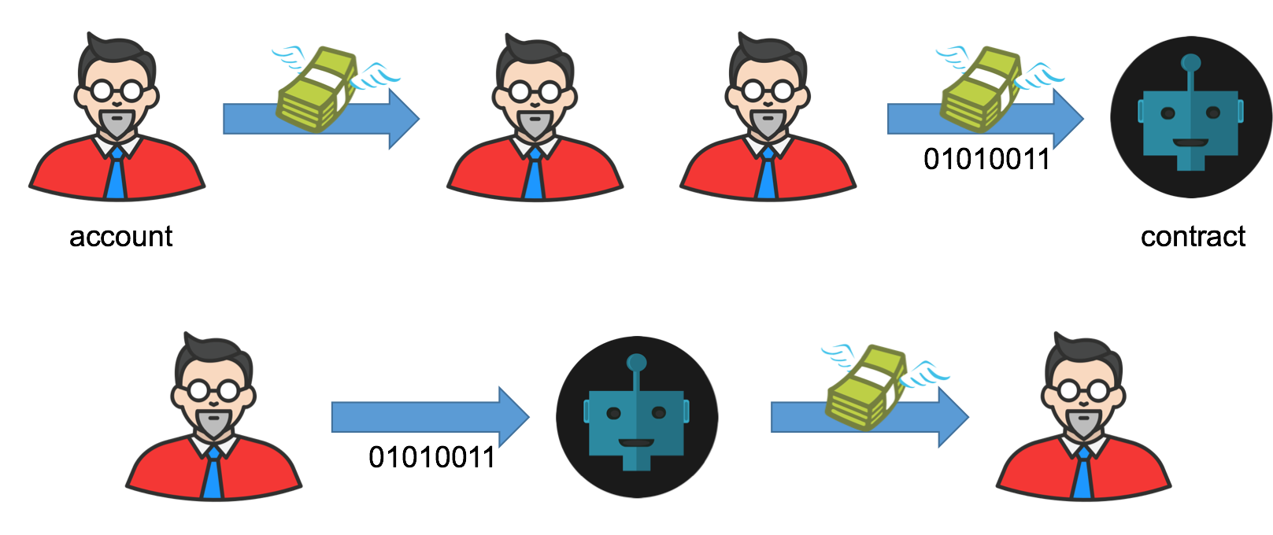

Edgeware MLC DoS (1/5)
MLC
LUC
EDG Addr
Term (3/6/12 months)
LUC
LUC

Slide 5
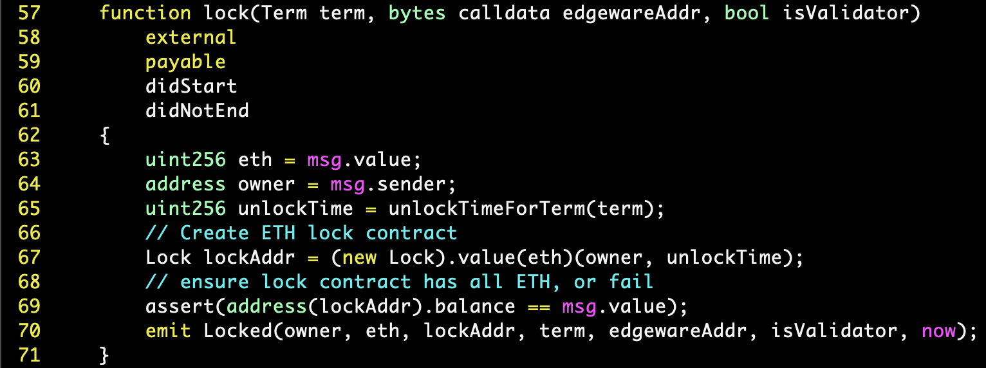
Edgeware MLC DoS (2/5)
create LUC contract and deposit ETH
DoS … Why?

Slide 6
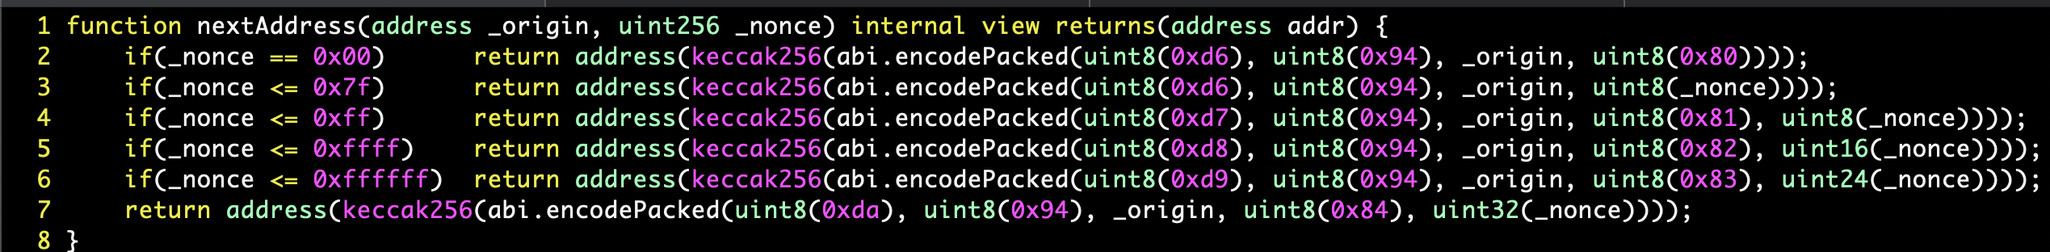


Edgeware MLC DoS: Exploit (3/5)
(MLC Addr, nonce)
LUC Addr
(MLC Addr, nonce+1)
LUC Addr 1
(MLC Addr, nonce+2)
LUC Addr 2
(MLC Addr, nonce+n)
LUC Addr n
Deposit ETH into LUC Addrs before They’re Created

Slide 7
Edgeware MLC DoS: Exploit (4/5)
MLC
LUC
revert
EDG Addr
Term (3/6/12 months)
address(lockAddr).balance >msg.value !!!
LUC
revert
LUC
revert

Slide 8
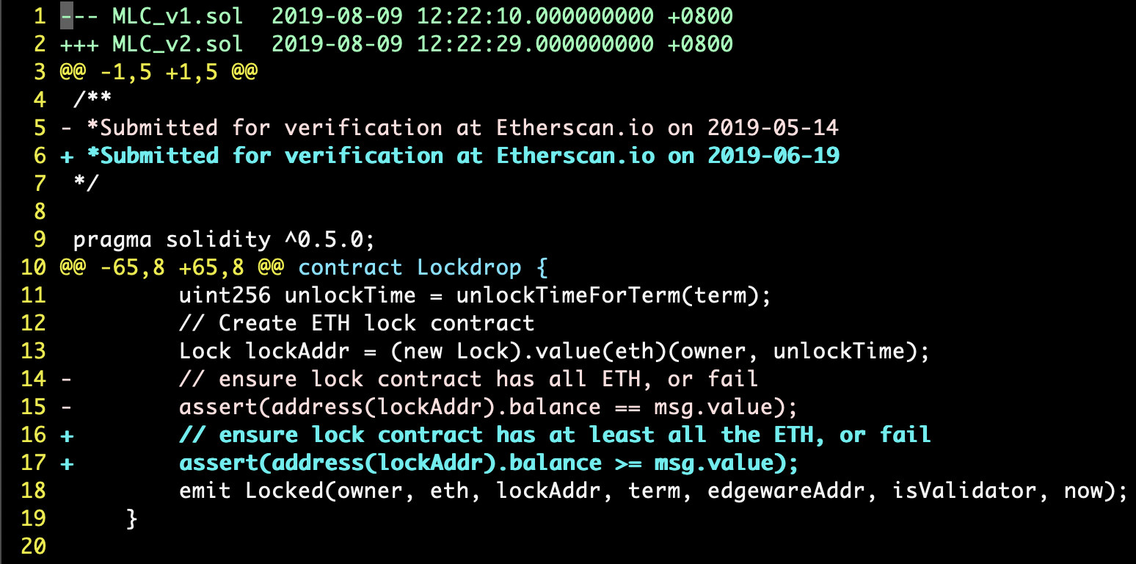
Edgeware MLC DoS: Patch (5/5)

Slide 9
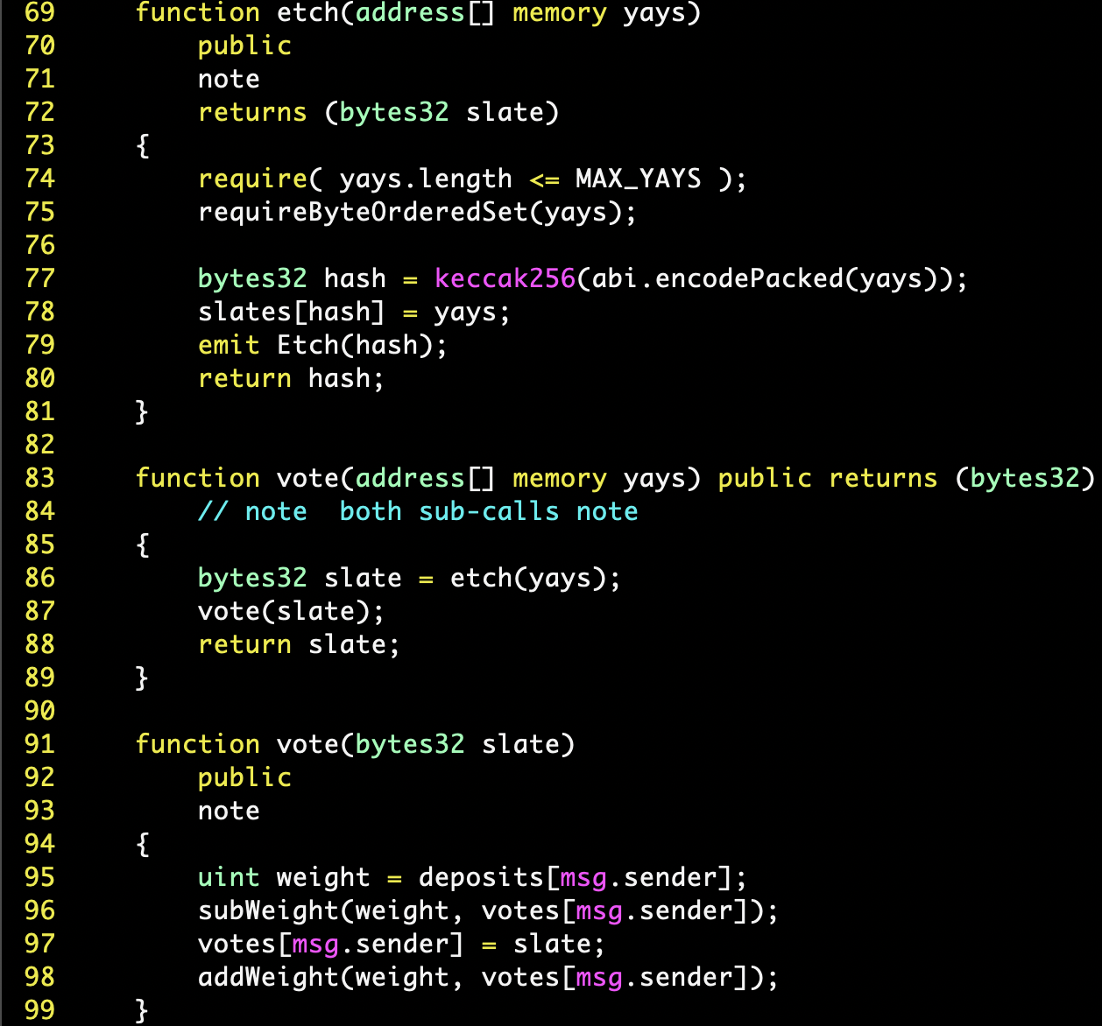
itchyDAO in MakerDAO Voting Contract (1/4)
2
1
3

Slide 10
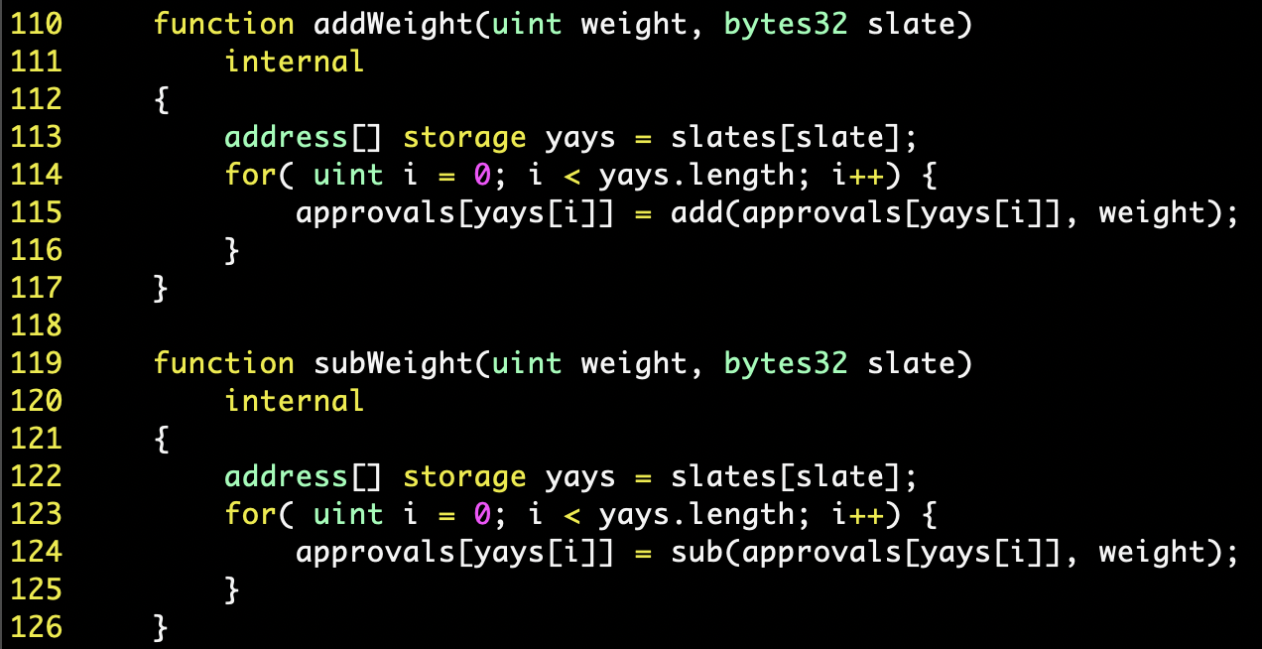
itchyDAO in MakerDAO Voting Contract (2/4)
yays.length = 0
3
yays.length = 0
1. pre-calculate a slate with one victim proposal and one “salt” proposal
2
do nothing due to slates[slate] is empty

Slide 11
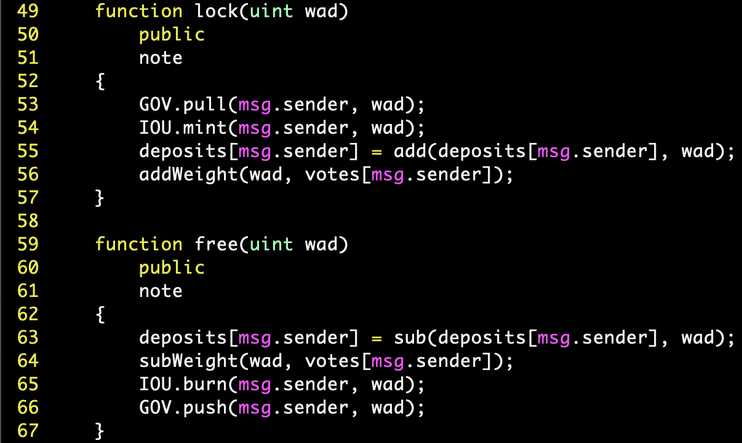
itchyDAO in MakerDAO Voting Contract (3/4)
The victim proposal is subWeight()’ed w/o any addWeight()
4

Slide 12
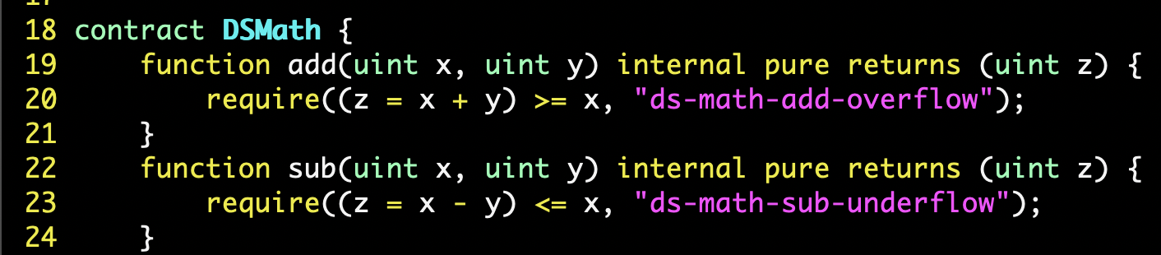
itchyDAO in MakerDAO Voting Contract (4/4)
A voter of the victim proposal can’t free() her tokens afterward.

Slide 13
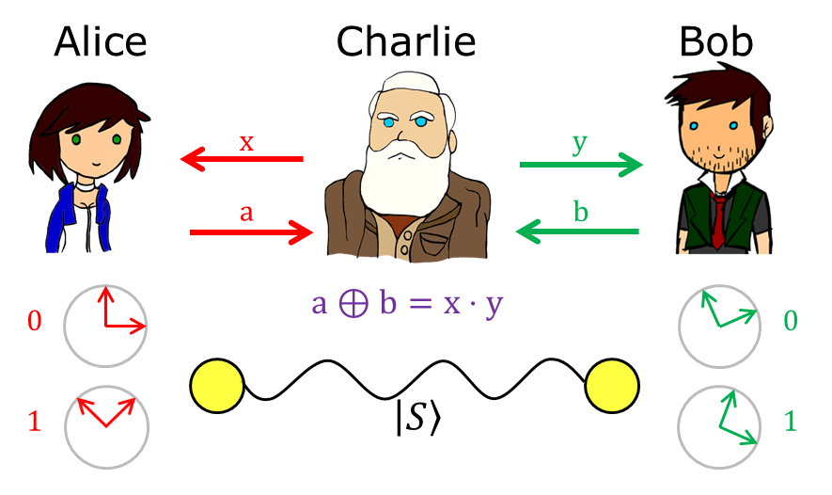
AirSwap Wrapper Authentication (1/5)
AirSwap v1
AirSwap v2
fill()
wrapper
swap()
Alice
(Alice, 1000, DAI addr, Bob, 6, 0x0)
Bob
Alice
Bob
(Alice, 1000, DAI addr, Bob, 6, WETH addr)
WETH

Slide 14
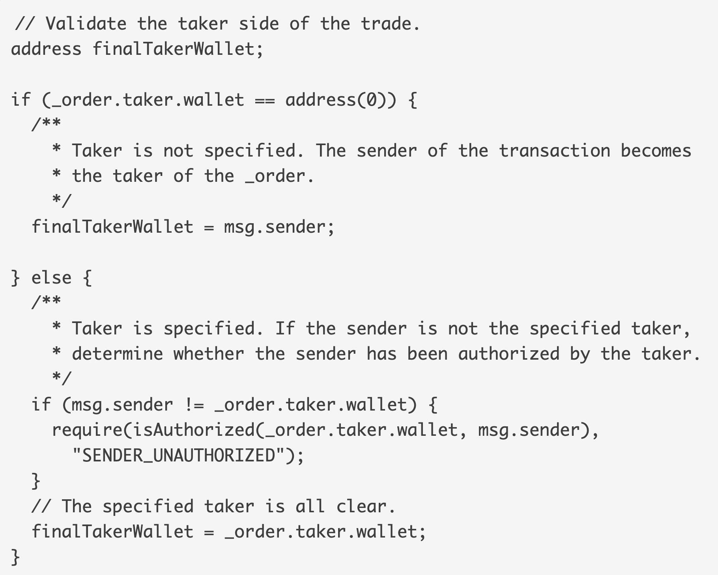
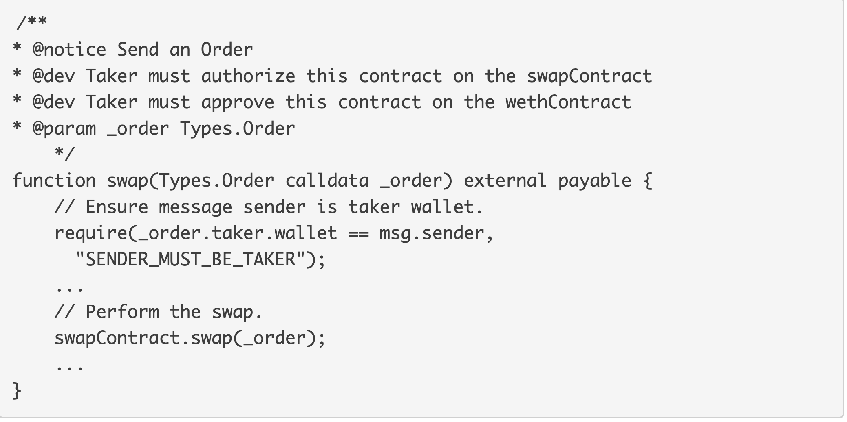
AirSwap Wrapper Authentication (2/5)
Swap
Wrapper
Taker needs to authorize the wrapper contract

Slide 15
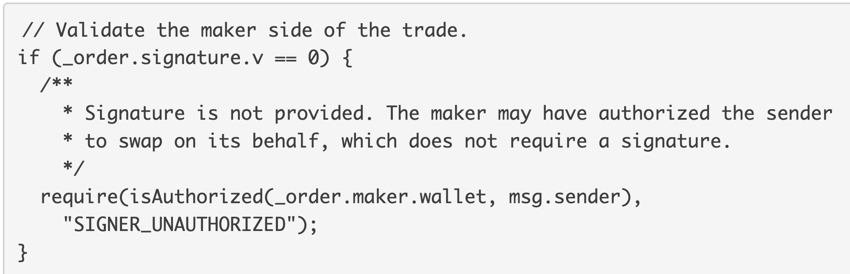
AirSwap Wrapper Authentication (3/5)
Swap
Swap
Anyone can impersonate a previous taker to “make” an order with signature.v = 0

Slide 16
AirSwap Wrapper Authentication (4/5)
(Alice, 1000, DAI addr, Bob, 6, WETH addr)
authorize(Wrapper)
AirSwap v2
Alice
Bob

Slide 17
AirSwap Wrapper Authentication (5/5)
???
(Alice, 1000, DAI addr, Bob, 6, WETH addr)
AirSwap v2
Alice
Bob
Bob
(Bob, 1000, DAI addr, BlackHat, 0, WETH addr)

Slide 18
Attack Vectors that You Should to Put More Eyes On
Smart Contract
Underlying EVM behaviors
0x, Edgeware
Corner cases that cause Denial-of-Service
Edgeware, MakerDAO
Excessive authorization that allow bad actors to trigger hidden logic
AirSwap
Oracle: Synthetix
Business Logic: HUSD

Slide 19

Thank You!
https://peckshield.com
contact@peckshield.com

